Slide 1
UNIT 2
Functions, Classes and Objects

Slide 2
Objectives
To recapitulate Functions and the importance of inline functions
To demonstrate overloading of functions
To discuss friend and virtual functions
To demonstrate C++ programs with a class and object and array of objects
To discuss memory allocation to objects

Slide 3
Outcomes
At the end of this unit, the student will be able to:
Explain the importance of functions and inline functions. [L 2, CO 1, PO 1]
Demonstrate inline functions and overloading of functions.[L 3, CO 1, PO3]
Discuss friend and virtual functions. [L 2, CO 1, PO 1]
Demonstrate C++ programs with a class, object and memory allocation to objects and array of objects. [L 3, CO 1, 3, PO 3]

Slide 4
Contents
Functions
Inline function
Function overloading
Friend and Virtual functions
Specifying a class
C++ program with a class
Memory allocation to objects
Array of objects

Slide 5
Functions

Slide 6
Functions - Call by reference

Slide 7
Functions - Return by reference

Slide 8
Inline Functions

Slide 9
Inline Functions

Slide 10
Function Overloading

Slide 11
Function Overloading

Slide 13
Friend and Virtual functions

Slide 15
Extensions to Structures in C++

Slide 16
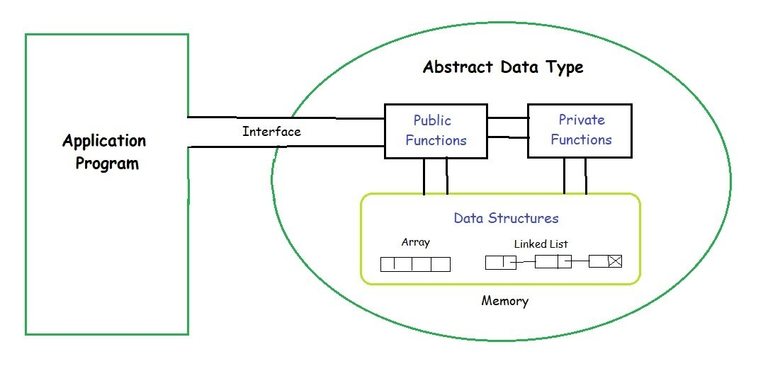

Slide 17
Specifying a Class

Slide 18
Data Hiding in Classes

Slide 19
Accessing Member functions of a class

Slide 20
Representation of a Class

Slide 22
Array of Objects

